Slide 1
SELF-OPERATING STREET LIGHT
AUTHORS : RAKSHITHA SHANKAR, SOWMYASHREE O A, NITHYASHREE C
Dept. of Computer Science and Engineering,
Channabasaveshwara Institute Of Technology, Gubbi, Karnataka, India.

Slide 2
CONTENTS
INTRODUCTION
PROBLEM STATEMENT
HARDWARE & SOFTWARE REQUIREMENTS
CIRCUIT DIAGRAM
CIRCUIT DESIGN
WORKING PROCEDURE
ADVANTAGES
APPLICATIONS
CONCLUSION

Slide 3
INTRODUCTION
In cities, Street Lights are one of the serious power consuming factors and the largest energy expenses for a city.
An intelligent lighting control system can reduce street lighting costs as much as to 70%.
The solution for this problem deals with Automated Street Light Control System based on Detection using Arduino board.

Slide 4
PROBLEM STATEMENT
A large amount of electricity of many towns and cities is being expended in all the night street light. In most of the areas the traffic density is very low during the late hours and midnight, there would be a huge waste of electricity resulting from such places if the streetlights are left unused. So the main aim of automated street lights is to reduce the power consumption when there are no any movements on the road.

Slide 5
HARDWARE & SOFTWARE REQUIREMENTS
Arduino 1.8.5 (IDE)
Arduino UNO R3
AC power supply
Light Dependent Resistor (LDR) Sensor
Cables
LEDs
2 Bulbs
Relay
Resistor 10K
IR Sensors – 4
Breadboard

Slide 6
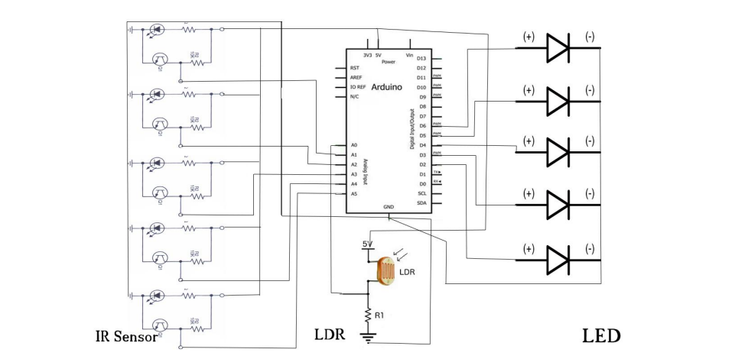
CIRCUIT DIAGRAM
Fig 1: Circuit diagram for Smart street light using IR sensors

Slide 7
CIRCUIT DESIGN
The following are the different steps included in building a Smart street light.
Output of the LDR pin is connected to A0 (analog) port of Arduino Uno board.
Connect all output of the IR sensors to port numbers A1, A2, A3, A4 and A5 respectively (analog) which is the input signal to the Arduino board.
Connect the ground of all the IR sensors to GND port.
The output signals from LED are connected to port number 5, 6, 9, 10 and 11 respectively.
Again connect all the negative terminals of LED’s to GND port.
Power is passed to the Arduino (7-12V)

Slide 8
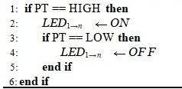
WORKING PROCEDURE
The IR transmitter is placed directly in line of sight with IR receiver, so that the IR receiver continuously receives infrared rays.
When a car or any other vehicle blocks any of the IR sensor, the microcontroller will turn ON the immediate LEDs.
If the car blocks the first IR sensor, the successive LEDs are turned ON by the microcontroller. As the car moves forward and blocks the next IR sensor, the corresponding next LEDs will be turned ON and the first LED of the previous set is turned OFF. The process continues this way for all the IR Sensors and LEDs.

Slide 9
ADVANTAGES
If the lighting system implements all LED lights, the cost of the maintenance can be reduced as the life span and durability of LEDs is higher than Neon based lights which are normally used as street lights.
As the lights are automatically turned ON or OFF, huge amount of energy can be saved.

Slide 10
APPLICATIONS
The street light control circuit can be used in normal roads, highways etc.
The project can also be used in parking areas of malls, hotels, industries etc.
This system requires less cost, less installation, less maintenance cost and more efficient as compared to the others system

Slide 11
CONCLUSION
By using Smart Street light, one can save surplus amount of energy which is done by replacing sodium vapor lamps by LED and adding an additional feature for security purposes.
The system is versatile, extendable and totally adjustable to user needs.
Continuous uses of LDR and IR sensors even in day time.
Not switched on before the sunset.
Moving with the new & renewable energy sources, this system can be upgraded by replacing ordinary LED modules with the solar based LED modules.

Slide 12
THANK YOU

